Slide 1
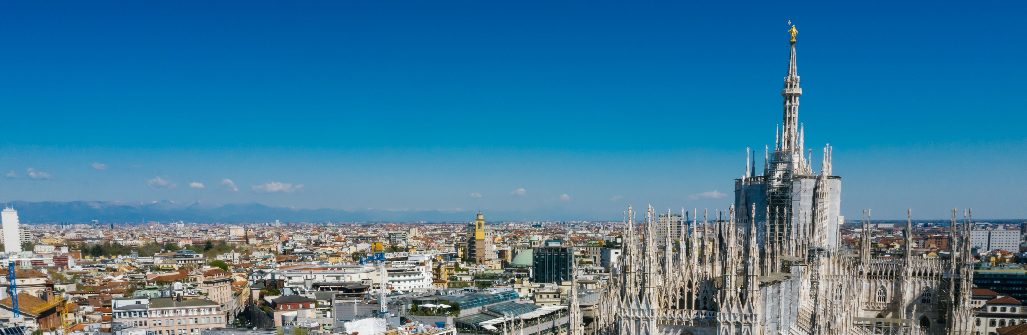

2nd Board of Beneficiaries
5–6 October 2026, Milan

